Slide 1
WORKING WITH MAKEFILE
AND
STATIC AND DYNAMIC LINK
BHAVANA
DAY 11
17/04/2024

Slide 2
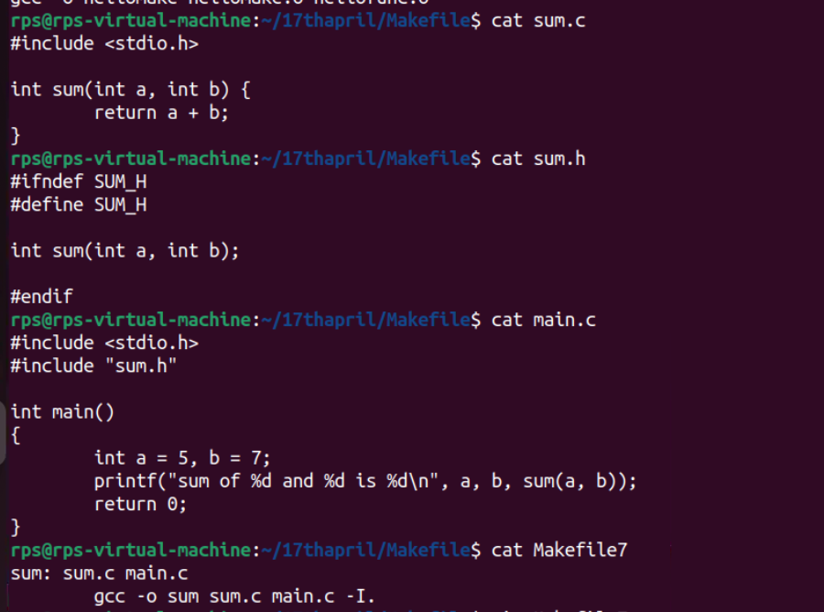

Slide 3
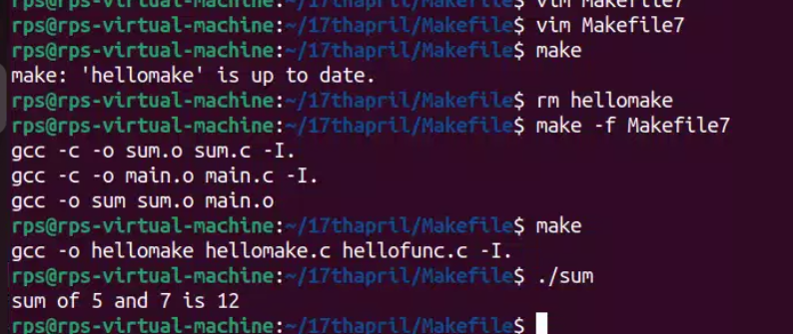

Slide 4
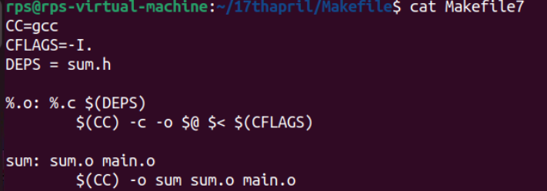

Slide 5
CC=gcc
CFLAGS=-I.
DEPS = hellomake.h
OBJ = hellomake.o hellofunc.o
%.o: %.c $(DEPS)
$(CC) -c -o $@ $< $(CFLAGS)
hellomake: $(OBJ)
$(CC) -o $@ $^ $(CFLAGS)
*Variables:* - CC=gcc: This sets the CC variable to gcc, indicating that the GNU Compiler Collection (gcc) will be used for compiling the code. - CFLAGS=-I.: This sets the CFLAGS variable to -I., which includes the current directory (.) in the compiler's search path for header files.
2. *Dependencies:* - DEPS = hellomake.h: This specifies the header file hellomake.h as a dependency. It indicates that if any of the source files (%.c) or the header file changes, the corresponding object files need to be recompiled.

Slide 6
3. *Object Files:* - OBJ = hellomake.o hellofunc.o: This specifies the object files that need to be created. These object files are prerequisites for the final executable hellomake.
4. *Pattern Rule for Compiling Object Files:* - %.o: %.c $(DEPS): This is a pattern rule that specifies how to compile .o object files from corresponding .c source files. It indicates that each .c file depends on the header file specified in DEPS. - $(CC) -c -o $@ $< $(CFLAGS): This line is the recipe for compiling a .c file into a .o object file. It uses the compiler specified by CC with options -c (compile only, do not link) and -o $@ (output to the file named on the left side of the colon, which is the target) and includes the flags specified in CFLAGS.
5. *Target Rule for Building the Executable:* - hellomake: $(OBJ): This specifies the target hellomake, which depends on the object files specified in OBJ. It indicates that the hellomake executable needs to be rebuilt whenever any of the object files change.
- $(CC) -o $@ $^ $(CFLAGS): This line is the recipe for linking the object files into the final executable named hellomake. It uses the compiler specified by CC with options -o $@ (output to the file named on the left side of the colon, which is the target) and includes the flags specified in CFLAGS. $^ refers to all the prerequisites (object files) needed for the target.

Slide 7
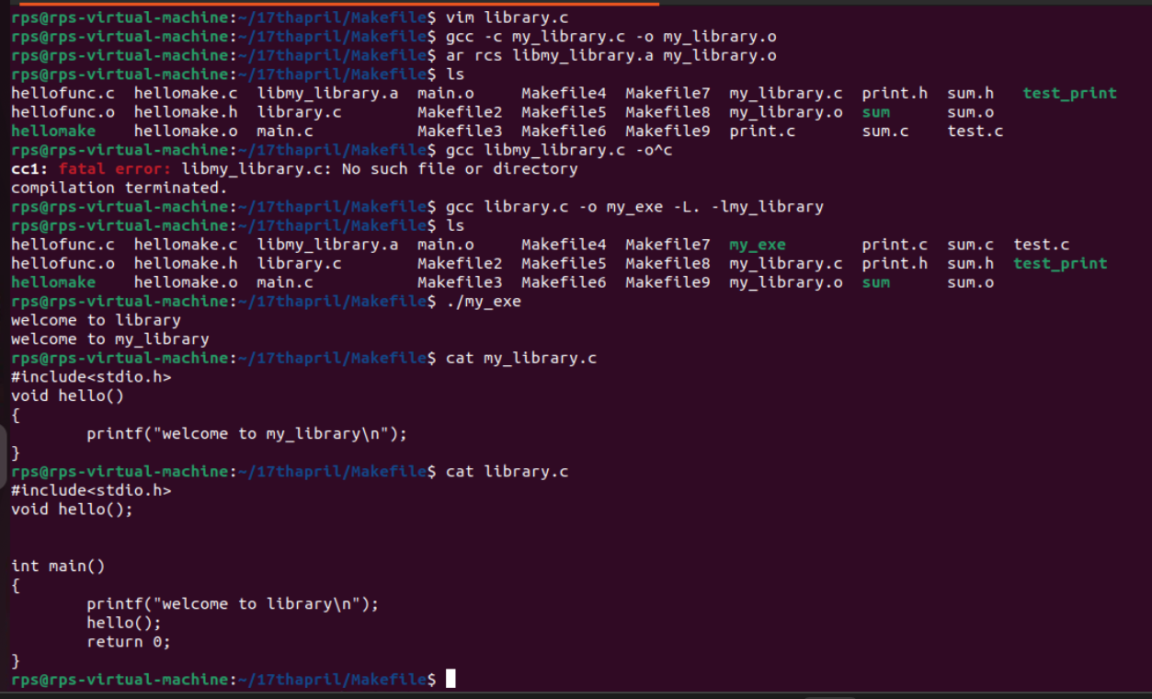
DEMONSTRATION OF STATIC LIBRARY:

Slide 8
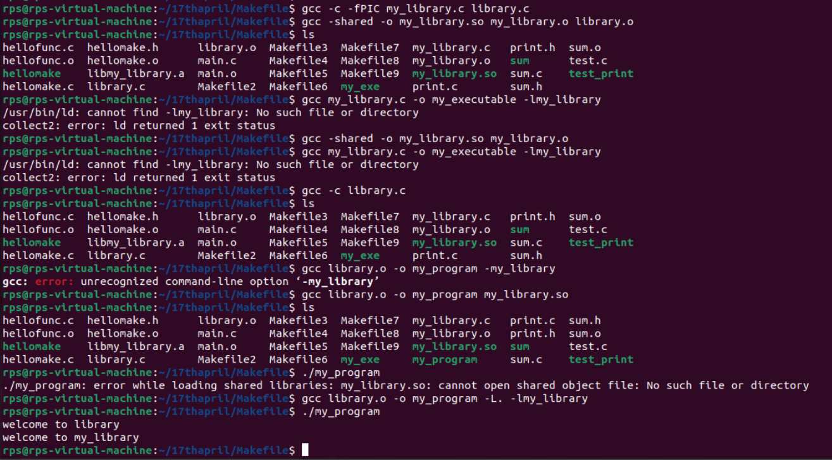
DEMONSTRATION OF DYNAMIC LIBRARY:
gcc -c -fPIC source_file1.c source_file2.c
gcc -shared -o my_library.so source_file1.o source_file2.o
gcc main_program.c -o my_executable -lmy_library

Slide 9
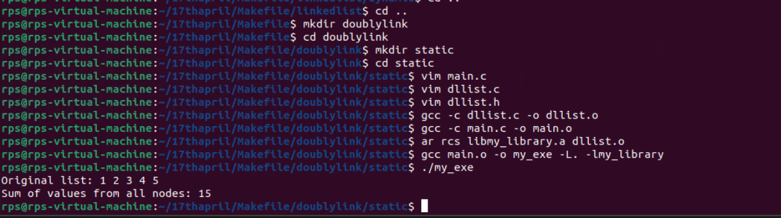
create a doubly link list of 5 nodes and add all values from all the nodes and print them using dynamic and static link , also create three files
USING STATIC LINK:

Slide 10
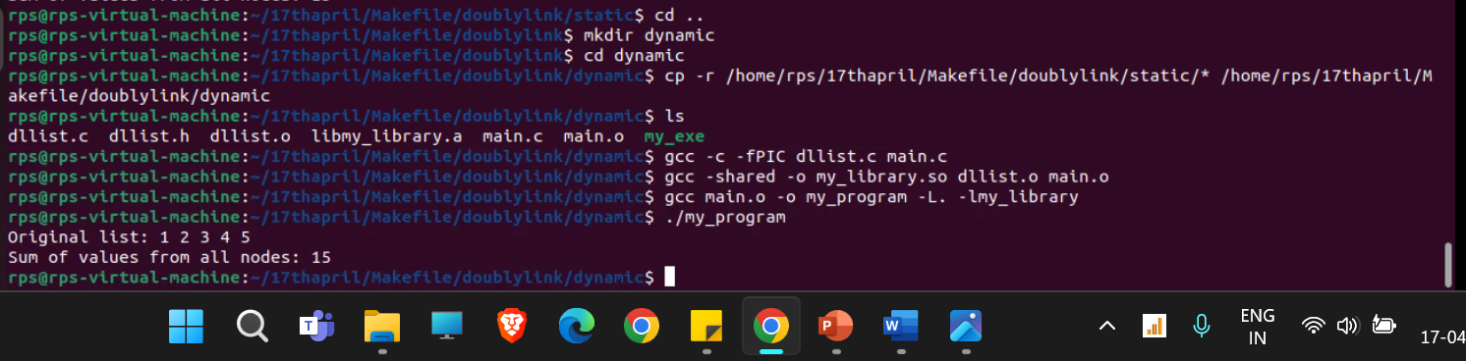
USING DYNAMIC LINK:

Slide 11
COMMANDS FOR SINGLY LINKED LIST -------------------------------- STATIC LINKING: --------------- vim main.c vim linklist.c vim linklist.h gcc -c main.c -o main.o gcc -c linklist.c -o linklist.o ar rcs libmy_library.a linklist.o gcc main.o -o my_exe -L. -lmy_library ./my_exe ------------------------------------------

Slide 12
DYNAMIC LINKING: ------------------ gcc -c -fPIC linklist.c main.c gcc -shared -o my_library.so linklist.o main.o gcc main.o -o my_program -L. -lmy_library ./my_program ------------------------------------------------------------------------------------------------
COMMANDS FOR DOUBLY LINKED LIST -------------------------------- STATIC LINKING: -------------- vim main.c vim dllist.c vim dllist.h gcc -c dllist.c -o dllist.o gcc -c main.c -o main.o
ar rcs libmy_library.a dllist.o gcc main.o -o my_exe -L. -lmy_library ./my_exe ----------------------------------------------------------

Slide 13
DYNAMIC LINKING" ----------------- gcc -c -fPIC dllist.c main.c gcc -shared -o my_library.so dllist.o main.o gcc main.o -o my_program -L. -lmy_library ./my_program ------------------------------------------------------------------------------------------------- -------------------------------------------------------------------------------------------------

Slide 14


